Slide 1

JAYOTI VIDYAPEETH women’s university, jaipur
INTERNATIONAL CONFERENCE
ON
“recent engineering trends in community development & women’s participation-ii”
etcdwp -2019
TOPIC- VEHICULAR COMMUNICATION
JV’n Shivani sharma
JV’n Khushi jha
JV’n Surbhi kumari

Slide 2
CONTENTS
INTRODUCTION
SIGNIFICENCE OF STUDY
ABSTRACT
OBJECTIVE OF STUDY
RESEARCH METHODOLOGY
CONCLUSION

Slide 3
INTRODUCTION
Recent studies shows that about 60% of roadway accidents could be avoided if the driver was warned just one-half second before the collision occurs. Actually, traffic accidents have become the main cause of mortality, quite above illnesses.
This paper is focused on the inter-vehicular communication (IVC). IVC has attracted research attention from the transport industry of Japan, EU and US. Within this area there are also a lot of different services that can be provided, and different strategies to implement them.
The main goal of IVC is to upgrade on-board devices (i.e. GPS, sensors) and, thus, to extend the horizon of drivers.

Slide 4
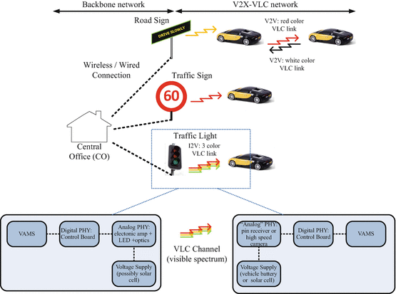

Slide 5
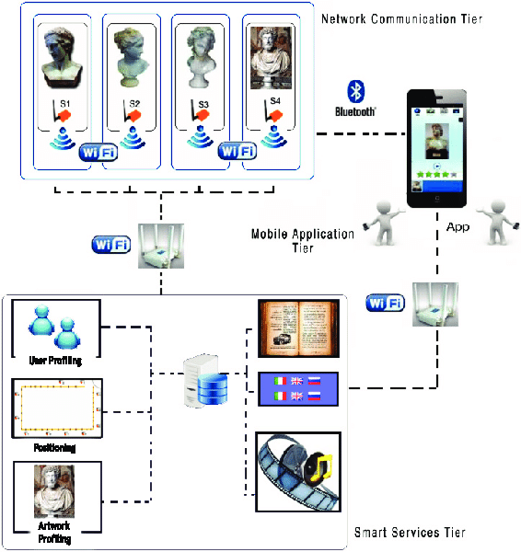

Slide 6
SIGNIFICENCE OF STUDY
When the communication occurs between vehicles, it is called Vehicle-to-Vehicle (V2V) communication.
It takes place in cooperative driver assistance or in decentralized floating car data sharing (i.e. traffic monitoring). If the communication is between a vehicle and a infrastructure, that is, Vehicle-to-infrastructure (V2I) communication, then vehicles can communicate using a fix infrastructure along the road to give support some services like Internet access, inter-vehicle chat, mobile advertising…etc.
The main purpose of Network on Wheels (NOW project) is to solve problems related to data security and communication protocols
.

Slide 7
Abstract-
Driver assistance systems are meant to support drivers with driving process in order to avoid traffic accidents, speed up the traffic and have a higher control over the traffic in general.
There are a lot of systems which give support to the drivers, such as adaptive cruise control, traffic sign recognition, automatic parking,etc.
In this paper we focus on the vehicular communication systems. These systems use the capacity of the vehicles to communicate, not only between them but also with infrastructures.
All the information is collected and processed to offer useful services. Wireless Sensor Networks (WSN) is widely used in this area. With the incoming upgrades of these networks, they are becoming an attractive solution to give support with the communication mechanisms between vehicles.

Slide 8
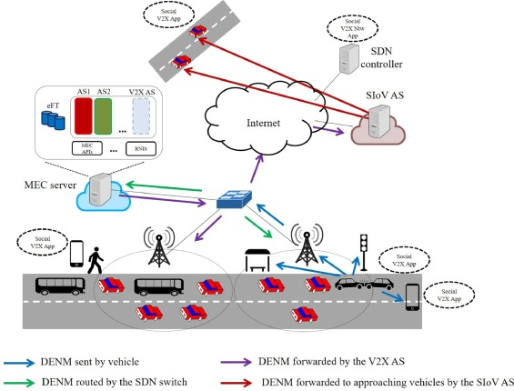
Exploitation of 4G/5G mobile communication infrastructures in V2V and V2I

Slide 9
OBJECTIVES OF STUDY-
In general, V2I communications have been implemented based on numerous standards, such as IEEE 802.11n, DSRC, and Infrared techniques.
They have been widely deployed for road charging applications but the infrastructure cost makes the cost/benefit calculation challenging, demanding significant investment overhead.
Wide Area Networking (WAN) technologies such as 2G/GPRS/EDGE, 3G/ UMTS/HSPA/HSPA+, and 4G/LTE have also been used for vehicle to back office communication, but these suffer from location accuracy which could be improved by secondary mechanism such as GPS.

Slide 10
RESEARCH METHODOLOGY-
The concept of (mostly neighboring) vehicles communicating with each other has been the subject of research and development initiatives for many years.
The level of adoption of V2V techniques in modern vehicles has only recently started to increase and it is still far below satisfactory levels. Lately, through the connectivity available for vehicles.
Most of applications are safety related, but these applications need real-time constraints that the IEEE 802.11p is not able to provide itself. So some extensions of the amendment are needed to allow the use of safety applications.
The communication could be based on the point to point or multipoint. It also demands the low latency requested by the real-time communication.

Slide 11
CONCLUSION-
This chapter has gone through the available standards for vehicular communications. Let it also be noted it was intentionally avoided to distinguish between V2V standards and V2I standards because many of them, especially the newest ones, have been designed so as to serve both types of communication.
The accident would not be avoided. On the other hand, the problem with V2I communications is that usually they require high installation costs. As a result, only a few cities can afford to have everywhere sensors and/or internet-enabled objects of the transportation infrastructure.
In conclusion, researchers are now trying to put into effect hybrid standards, in that they should enable both V2V and V2I communications.

Slide 12
THANK YOU ☺

